Slide 1
UNIT NO – 6 Logical Venn Diagrams, Logical Deductions
SUBJECT : (QALR)
DEPARTMENT OF MATHEMATICS SNIST

Slide 2
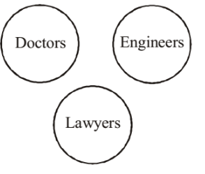
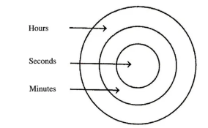
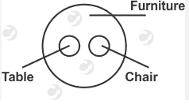
Logical Venn Diagrams
1) Doctors, Engineers & Lawyers
2)Seconds, minutes, hours
3) Table, chair, Furniture

Slide 3
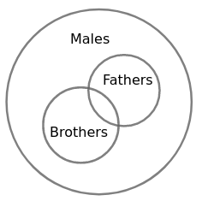
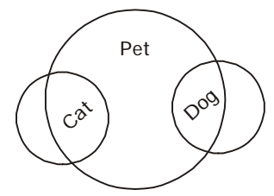
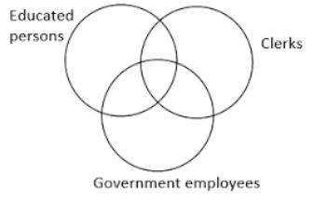
4) Males, Fathers, Brothers
5) Dogs, Pets, Cats
6) Clerks, Government Employees, Educated Persons

Slide 4
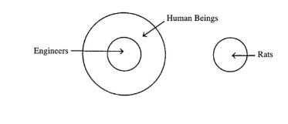
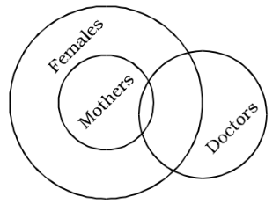
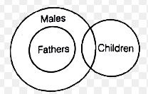
7) Engineers, Human Beings, Rats
8) Females, Mothers, Doctors
9) Males, Fathers, Children

Slide 5
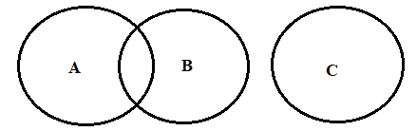
10) Professor, Author, Children
A:Professor,B:Author,C:Childern.

Slide 6
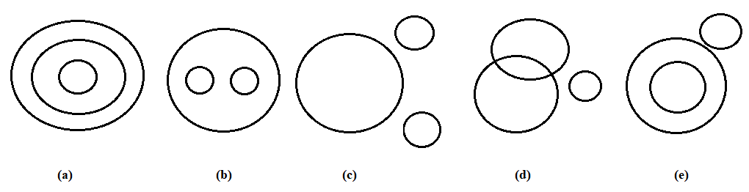
Problem:
A)
1) Vegetables, Potato, Cabbage
Sol) b
2) Table, Chair, Furniture
Sol) b
3) Week, Day, Year
Sol) a

Slide 7
4) Judge, Thief, Criminal
Sol) e
5) Husband, Wife, Family
Sol) b
6) Square, Rectangle, Polygon
Sol) a
All squares are rectangles and all rectangles are polygons
7) Bus, Car, Vehicle
Sol) b
8) Anxiety, Intelligence, Strength
Sol) c
9) House, Bedroom, Bathroom
Sol) b
10) Mustard, Barely, Potato
Sol) c

Slide 8
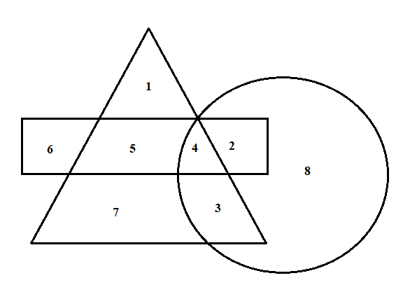
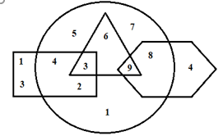
Type – 2
Which number is in all the geometrical figures?
Sol) 4

Slide 9
B)
1) Which number belongs to all the figures?
Sol) None
2) What is the sum of the numbers which belong to two figures only?
Sol)
Numbers common to square and oval: 2,4
Numbers common to Triangle and oval: 6
Numbers common to Hexagon and oval: 8
Sum = 20

Slide 10
3) What is the product of the numbers which belong to 3 figures only?
Sol) 3 x 9 = 27
4) What is the sum of the numbers which belong to one figure only?
Sol) 21
5) What is the product of the numbers which belong to 2 figures only?
Sol) 2 x 4 x 6 x 8 = 384

Slide 11
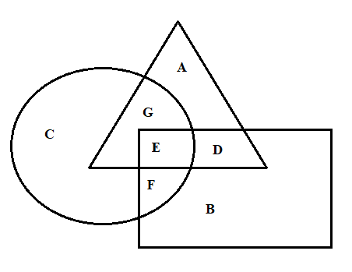
Type – 3:
The triangle in the above figure depicts women in villages, the square depicts the unemployed women and the circle depicts the educated women.
1) Educated employed women in villages are represented by?
Sol) G
2) What does letter D represents?
Sol) Unemployed women in village who are not educated.
3) Educated unemployed women in villages are represented by?
Sol) E
4) Educated unemployed women are represented by?
Sol) F

Slide 12
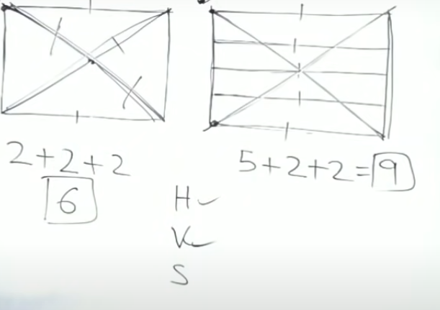
Analytical Reasoning:

Slide 13
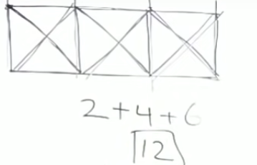
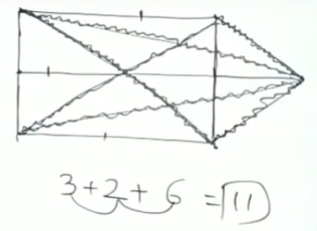

Slide 14
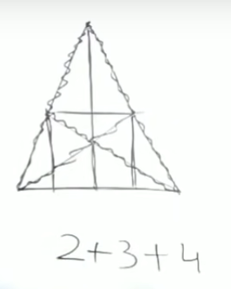
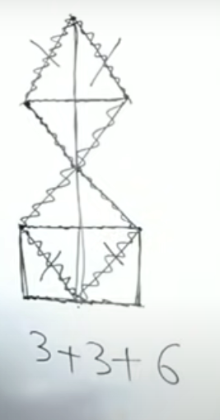

Slide 15
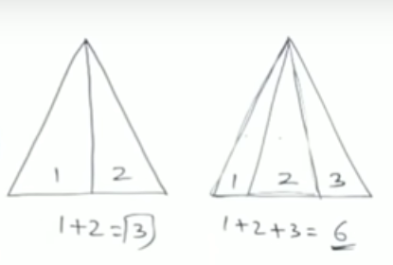
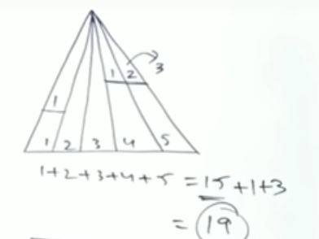
Find the number of Triangles?

Slide 16
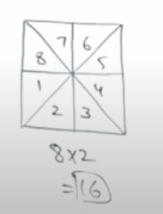
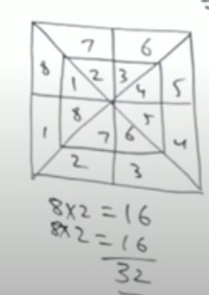
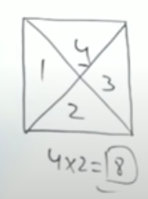

Slide 17
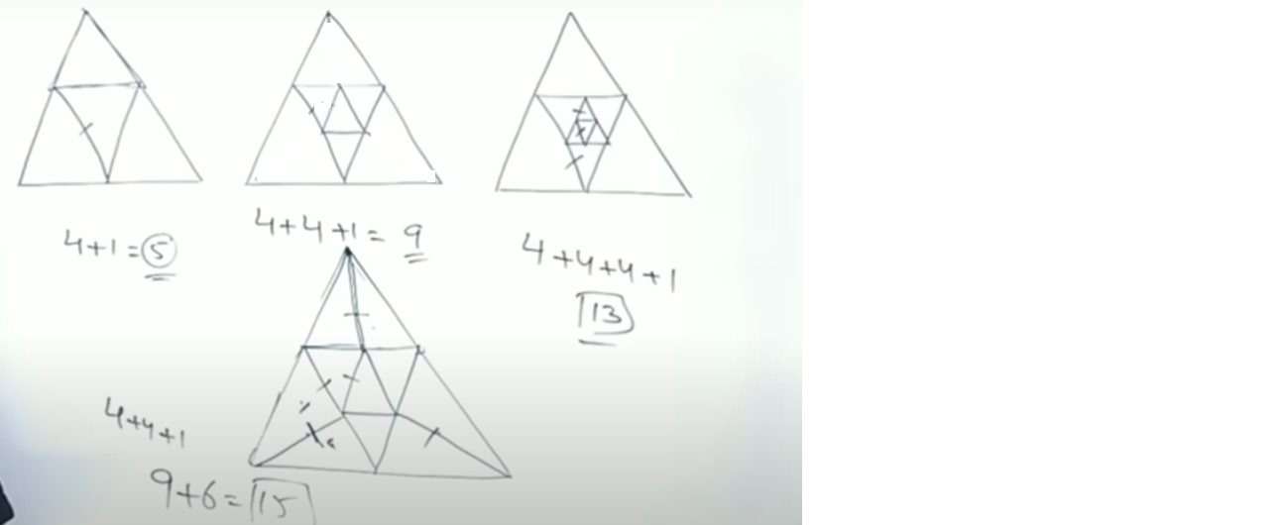

Slide 18
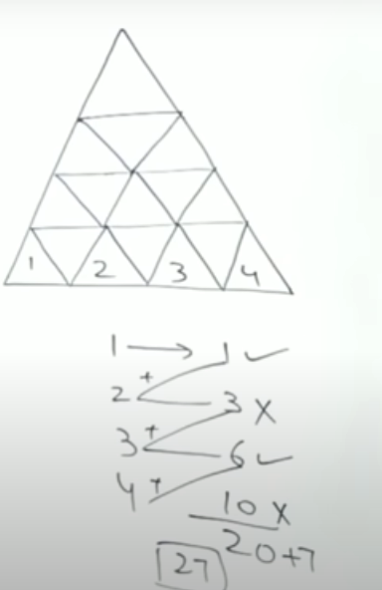
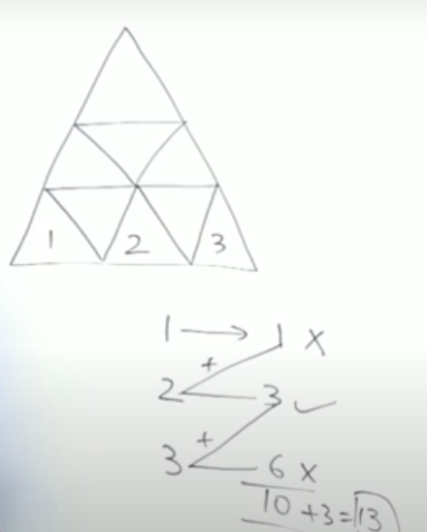

Slide 19
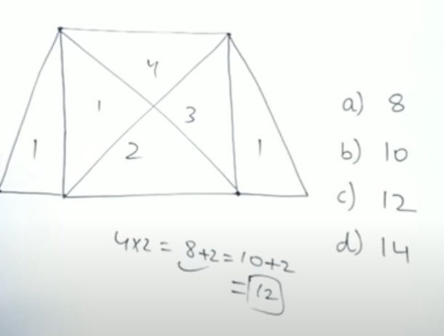

Slide 20
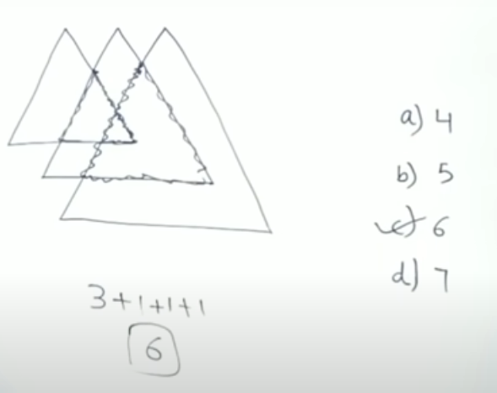

Slide 21
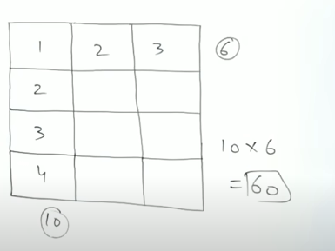
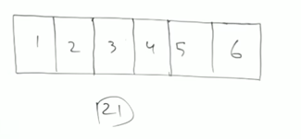
Find the number of Rectangles ?

Slide 22
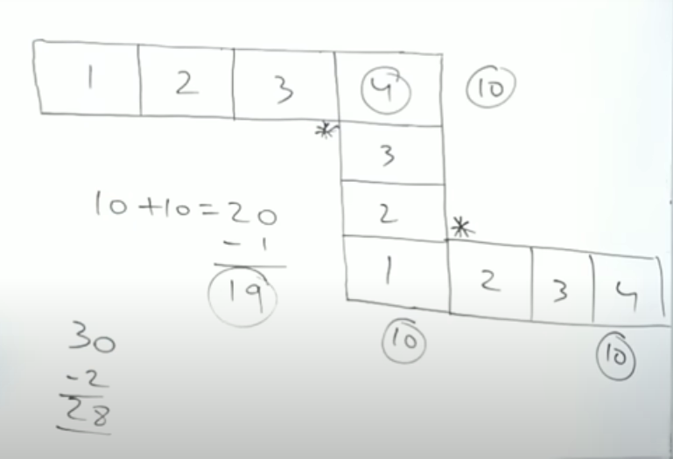

Slide 23
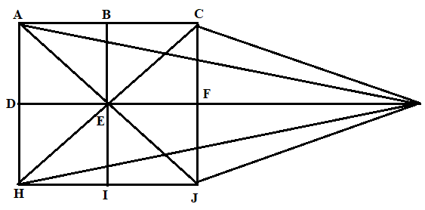
1) What is the number of SL in the following figure ?
Sol) H :3, V :3, Slanting lines : 6
Total: 12

Slide 24
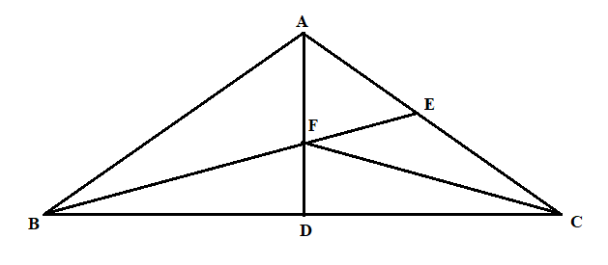
2) How many Triangles are there in the Following Figure
Sol) Simplest 1 components: 5
Simplest 2 components: 4
Simplest 3 components: 2
Simplest 5 components: 1
Total: 12

Slide 25
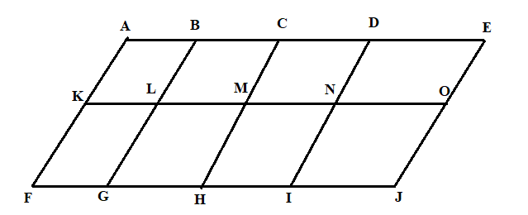
3) How many parallelograms are there in the following figure?
Sol) 1 component: 8
2 component: 10
3 component: 4
4 component: 5
6 component: 2
8 component: 1
Total: 30

Slide 26
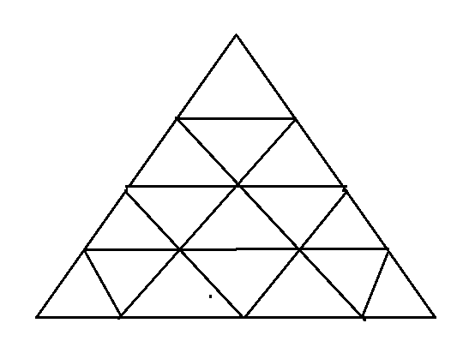
4) Find the minimum number of Sl required to make the figure?
Sol) H: 4
Slanting: 7
Total: 11

Slide 27

5) In the adjoining figure if the centers of all the circles are joined by horizontal & vertical lines, then find the number of squares that can be formed?
Sol) 8

Slide 28
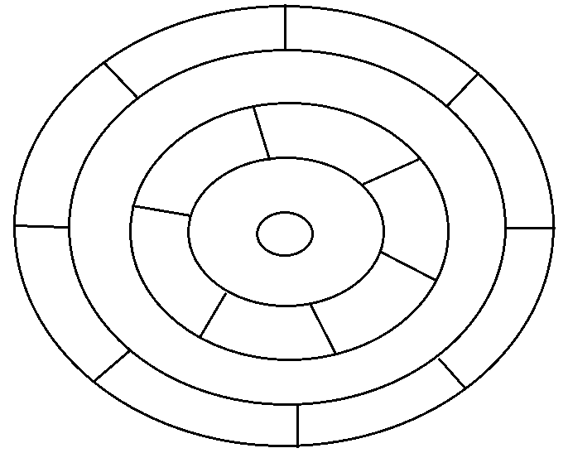
6) What is the minimum number of different colors required to paint the figure below such that no 2 adjacent regions have the same color?
Sol) 3

Slide 29

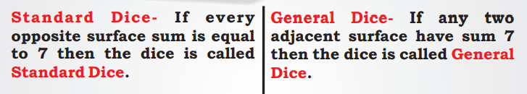
DICE AND CUBES
A dice is a small form of a cube. It is a three dimensional shape and it has 6 surfaces/slides/faces. Generally, the length, width and height of a dice is equal. But there are some dice whose length, width and height are unequal. The surface of each dice is attached to four other adjacent surfaces/sides and the surface which is not attached is just opposite of that surface. Generally, a dice is represented by 1 to 6 digit. Sometimes it is also represented by diagrams or alphabets.
Types of Dice: There are two types of Dice.

Slide 30
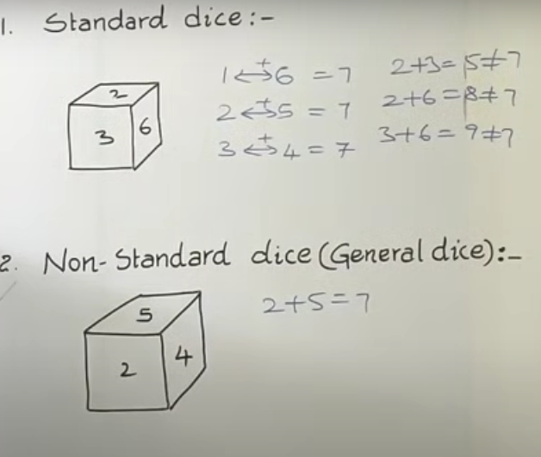

Slide 31
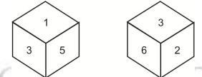
DIFFERENT CASES OF DICE WHEN OPPSITE NUMBER /ALPHA /SYMBOL
CASE 1:-One side/Surface Common
One of the surface is common in both i.e. digit 3. When we write in clockwise direction from the common surface of both the dice then it will be
From first dice (clockwise ) 3 - 1- 5
From second dice (clockwise ) 3- 2 - 6
Therefore, the opposite of 1 is 2 and 5 is 6, and the opposite surface of 3 will be that surface which cannot be seen i.e
4 Opposite of 3 is 4 Opposite of 1 is 2 Opposite of 5 is 6

Slide 32
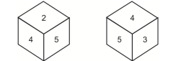
CASE 2: When two sides are common
When a dice is shown in different positions and any two of the positions has two common sides or two different positions of the same dice are shown then top find out the opposite of two common sides, the following formula can be applied.
Example 9: Given below are the two positions of a dice in which two sides or surfaces are common. The two common sides are 4 and 5. (1) The remaining side other than the two common sides ( 4 and 5 ) of the first dice position is 2 and the remaining sides other than the two sides ( 4 and 5 ) of the second dice position is 3. So, 2 and 3 is opposite to each other. Therefore,

Slide 33
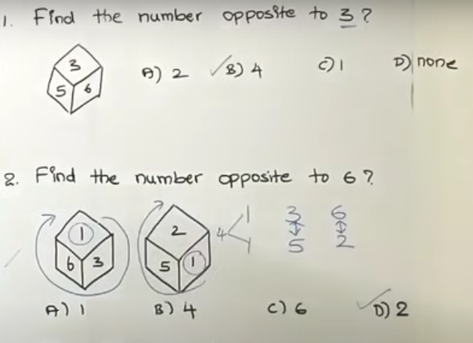
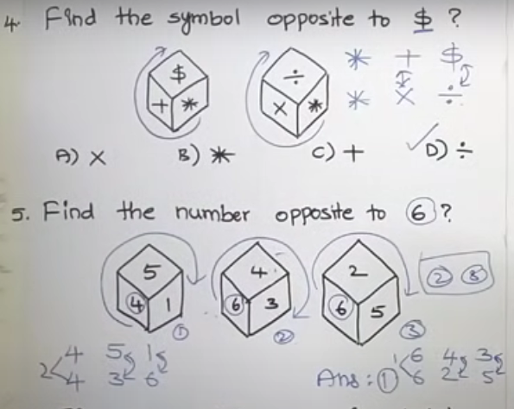
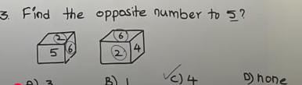

Slide 34
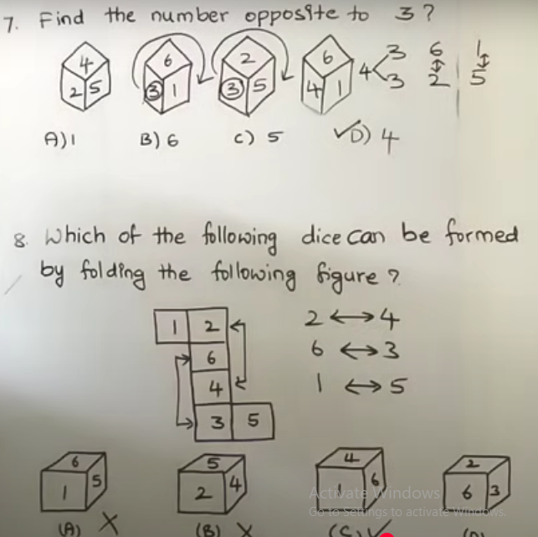
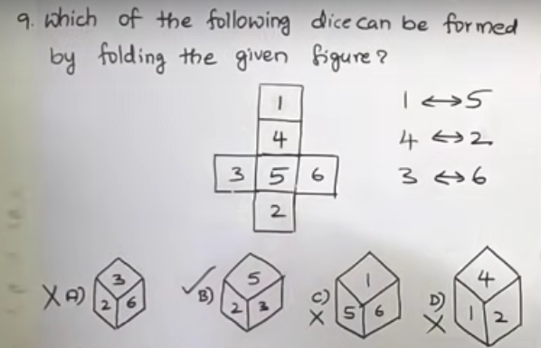
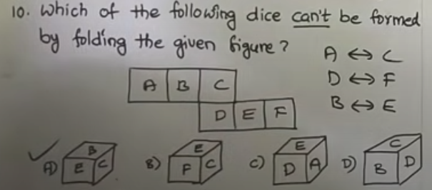

Slide 35
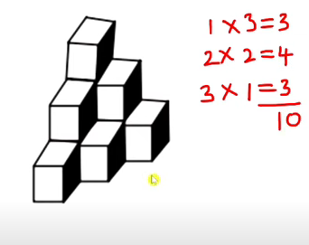
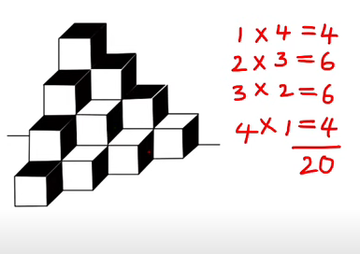
Counting Cubes
Problem 1.
Problem 2.

Slide 36
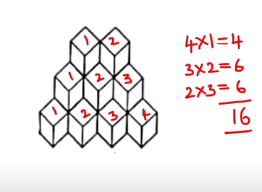

Problem 3
Problem 4

Slide 37


Problem 5
Problem 6

Slide 38


Slide 39



Slide 40

Assertion and Reason

Slide 41

Both are correct R is correct explanation of A (a)

Slide 42


Slide 43


Both are correct R is correct explanation of A (a)

Slide 44

Both are correct R is correct explanation of A (a)

Slide 45



Slide 46



Slide 47
DATA SUFFICIENCY

Slide 48


Slide 49


Slide 51


Slide 52


Slide 53


More problems on DATA SUFFICIENCY

Slide 54


Slide 55


Slide 56

d) The given data in both the statements I and II together are not sufficient to answer the questions.

Slide 57


Slide 58

d) The given data in both the statements I and II together are not sufficient to answer the questions.

Slide 59


Slide 60

d) The given data in statement I alone or II alone are sufficient to answer the questions.

Slide 61


Slide 62

d) The given data in statement I alone or II alone are sufficient to answer the questions.

Slide 63


Slide 64

e)If the data in both statements I and II together are necessary to answer the questions.

Slide 65

c)If the data either in statement alone I or in statement II alone
are sufficient to answer the question

Slide 66


Slide 67

c)If the data either in statement alone I or in statement II alone
are sufficient to answer the question

Slide 68

b)Only II I sufficient while the statement I alone is insufficient to answer the question.

Slide 69



Slide 70
LOGICAL DEDUCTION
LOGIC:
The word ‘logic’ is derived from the Greek noun ‘logos’ meaning both ‘thought’ and ‘the word expressing thought’.
Thus, logic is the ‘science of thought as expressed in language’. This means that the questions on logic are to be solved as per the information given without any concern of the formal validity on truth of the statement i.e., conclusions should follow directly from the statements given.
With this unique characteristic , the logic test becomes an instrument of teaching the candidates to follow the rules and work as per the instructions without an error. Thus, it prepares the mind for all types of reasoning practices and teaches how to detect and avoid mistakes in the same.

Slide 71
LOGICAL REASONING:
In logic, any categorical statement is termed as the Proposition.
A proposition ( or a categorical statement) is a statement that asserts that either a part of, or the whole of, one set of objects- the set identified by the subject term in the sentence expressing that statement- either is included in, or is excluded from, another set- the set identified by the predicate term in that sentence.
The standard form of a proposition is:
Quantifier + Subject + Copula + Predicate

Slide 72
Thus, the proposition consists of four parts:
Quantifier : the words ‘all’, ‘no’ and ‘some’ are called quantifiers because they specify a quantity. ‘All’ and ‘no’ are universal quantifiers because they refer to every object in a certain set, while the quantifier ‘some’ is a particular quantifier because it refers to at least one existing object in a certain set.
Subject (denoted by ‘S’) : the subject is that about which something is said.
Predicate (denoted by ‘P’) : the predicate is the part of the proposition denoting that which is affirmed or denied about the subject.
Copula : the copula is that part of the proposition which denotes the relation between the subject and the predicate.

Slide 73
Examples :
All men are animals
↓ ↓ ↓ ↓
Quantifier subject Copula Predicate
Some pens are erasers
↓ ↓ ↓ ↓
Quantifier Subject Copula Predicate

Slide 74
FOUR-Fold Classification of Prepositions:
Preposition is said to have a universal quantity if it begins with a universal quantifier, and a particular quantity if it begins with a particular quantifier. Besides, propositions which assert something about the inclusion of the whole or a part of one set in the other are said to have confirmative quality, while those which deny the inclusion of the whole or a part of one set in the other are said to have a negative quality. Also, a term is distributed in a proposition if it refers in all members of the set of objects denoted by that term. Otherwise, it is said to be undistributed.

Slide 75
Based on the above facts, propositions can be classified into four types:
1) Universal Affirmative Proposition (denoted by A): It distributes only the subject i.e., the predicate is not interchangeable with the subject while maintaining the validity of the proposition e.g.,
All snakes are reptiles.
This is proposition A since we cannot say ‘All reptiles are snakes’.
2) Universal Negative Proposition (denoted by E): It distributes both the subject and the predicate i.e. an entire class of predicate term is denied to the entire class of the subject term, as in the proposition.
E.g.,No boy is intelligent.

Slide 76
3) Particular Affirmative Proposition (denoted by I): It distributes neither the subject nor the predicate e.g.,
Some men are foolish.
Here, the subject term ‘men’ is used not for all but only for some men and similarly the predicate term ‘foolish’ is affirmed for a part of subject class. So, both are undistributed.
4) Particular Negative Proposition (denoted by O): It distributes only the predicate. E.g.,
Some animals are not wild.
Here, the subject term ‘animals’ is used only for a part of its class and hence is undistributed while the predicate term ‘wild’ id denied in entirely to the subject term and hence is distributed.

Slide 77
These facts can be summarized as follows:
Statement Form | Quantity | Quality | Distributed
(A): All S is P. | Universal | affirmative | S only
(E): No S is P. | Universal | Negative | Both S and P
(I): some S is P. | Particular | Affirmative | Neither S nor P
(O): some S is not P. | Particular | Negative | P only

Slide 78
The phenomenon of deriving a conclusion from a single proposition or a set of given propositions is known as logical deduction. The given proposition are also referred to as the premises.
Two inferential Processes of deduction
A) Immediate Deductive Inference:
Here, conclusion is deduced from one of the given propositions, by any of the three ways- conversion, obvers ion and contraposition.
1) Conversion : The Conversion proceeds with interchanging the subject term and the predicate term i.e., the subject term of the premise becomes the predicate term of the conclusion and the predicate term of the premise becomes the subject of the conclusion.
The given proposition is called converted, whereas the conclusion drawn from it is called its converse.

Slide 79
Table of Valid Obversions
CONVERTED | CONVERSE
A : All S is P. Ex. All pins are tops. | I : Some P is S Some tops are pins.
E : No S is P. Ex. No fish is whale. | E : No P is S. No whale is fish.
I : Some S is P. Ex. Some boys are poets. | I : Some P is S. Some poets are boys.
O : Some S is not P. | No valid conversion
Note that in a conversion, the quality remains the same and the quantity may change.

Slide 80
2) Obversion : In obversion, we change the quality of the proposition and replace the predicate term by its complement.
Table of Valid Obversions
Obversion | Obverse
A : All birds are mammals | E : no birds are non-mammals.
E : No poets are singers. | A : All poets are non-singers.
I : some nurses are doctors. | O : some nurses are not non-doctors.
O : Some politicians are not statesmen. | I : Some politicians are non-statesmen.

Slide 81
3) Contraposition : To obtain the contrapositive of a statement, we first replace the subject and predicate terms in the proposition and then exchange both these terms with their complements.
Table of Valid Contrapositions
Note : the valid converse, observe or contrapositive of a given proposition always logically follows from the proposition.
Proposition | Contraposition
A : All birds are mammals | A : All non-mammals are non-birds.
I : Some birds are mammals. | I : Some non-mammals are non-birds

Slide 82
B) Mediate Deductive Inference (SYLLOGISM) : First introduced by Aristotle, a syllogism is a deductive argument in which conclusion has to be drawn from two propositions referred to as the premises.
Examples : 1. All lotus are flowers.
2. All flowers are beautiful.
3. All lotus are beautiful.
Clearly, the preposition 1 and 2 are the premises and the proposition 3, which follows from the first two propositions, is called the conclusion.

Slide 83
Term : In Logic, a term is a word or a combination of words, which by itself can be used as a subject or predicate of a proposition.
Syllogism is concerned with three terms:
Major Term : It is the predicate of the conclusion and is denoted by P (first letter of ‘Predicate’).
Minor Term : It is the subject of the conclusion and is denoted by S (first letter of ‘Subject’).
Middle Term : It is the term common to both the premises and is denoted by M (first letter of ‘Middle’).

Slide 84
Example : Premises: 1. All dogs are animals.
2. All tigers are dogs.
Conclusion: All tigers are animals.
Here ‘animals’ is the predicate of the conclusion and so, it is the major term, P.
‘Tiger’ is the subject of the conclusion and so, it is the minor term, S.
‘Dogs’ is the term common to both the premises and so, it is the middle term, M.

Slide 85
Major and Minor Premises : Of the two premises, the major premise is that in which the middle term is the subject and the minor premise is that in which the middle term is the predicate.
Rules for Deriving the Conclusion from Two Given Premises
1) The conclusion does not contain the middle term.
Example. Statements : 1. All men are girls.
2. Some girls are students.
Conclusions : 1. All girls are men.
2. Some girls are not students.
Since both the conclusions 1 and 2 contain the middle term ‘girls’, so neither of them can follow.

Slide 86
2) No term can be distributed in the conclusion unless it is distributed in the premises.
Example. Statements: 1. Some dogs are goats
2. All goats are cows.
Conclusion : 1. All cows are goats.
2. Some dogs are cows.
Statement 1 is an I-type proposition which distributes neither the subject nor the predicate.
Statement 2 is an A-type proposition which distributes the subject i.e., ‘goats’ only.
Conclusion 1 is an A-type proposition which distributes the subject ‘cow’ only.
Since the term ‘cows’ is distributed in conclusion 1 without being distributed in the premises, so conclusion 1 cannot follow.

Slide 87
3) The middle term (M) should be distributed at least once in the premises. Otherwise, the conclusion cannot follow .
For the middle term to be distributed in a premise,
M must be the subject if premise is an A-proposition.
M must be subject or predicate if premise is an E proposition.
M must be predicate if premise is an O proposition.
Note that in an I proposition, which distributes neither the subject nor the predicate, the middle term cannot be distributed.

Slide 88
Example. Statements : 1. All fans are watches.
2. Some watches are black.
Conclusion : 1. All watches are fans.
2. Some fans are black.
In the premises, the middle term is ‘watches’. Clearly, it is not distributed in the first premise which is an A proposition as it does not form its subject. Also, it is not distributed in the second premise which is an I proposition. Since the ,middle term is not distributed even once in the premises, so no conclusion follows.

Slide 89
4) No conclusion follows
a) If both the premises are particular
Example. Statements : 1. Some books are pens.
2. Some pens are erasers
Conclusion : 1. All books are erasers
2. Some erasers are books.
Since both the premises are particular, so no definite conclusion follows.
b) If both the premises are negative
Example. Statements : 1. No flower is mango.
2. No mango is cherry.
Conclusion : 1. No flower is cherry.
2. Some cherries are mangoes.
Since both the premises are negative, neither conclusion follows.

Slide 90
c) If the major premise is particular and the minor premise is negative
Example : Statements : 1. Some dogs are bulls.
2. No tigers are dogs.
Conclusion : 1. No dogs are tigers.
2. Some bulls are tigers.
Here, the first premise containing the middle term ‘dogs’ as the subject is the major premise and the second premise containing the middle term ‘dogs’ as the predicate is the minor premise.
Since the major premise is particular and the minor premise is negative, so no conclusion follows.
5) If the middle term is distributed twice, the conclusion cannot be universal.
Example. Statements : 1. All fans are chairs.
2. No tables are fans.
Conclusions : 1. No tables are chairs.
2. Some tables are chairs.
Here, the first premise is an A proposition and so, the middle term ‘fans’ forming the subject is distributed. The second premise is an E proposition and so, the middle term ‘fans’ forming the predicate is distributed. Since the middle term is distributed twice, so the conclusion cannot be universal.

Slide 91
6) If one premise is negative, the conclusion must be negative.
Example. Statements : 1. All grasses are trees.
2. No tree is shrub.
Conclusions : 1. No grasses are shrubs.
2. Some shrubs are grasses.
Since one premise is negative, the conclusion must be negative. So, conclusion 2 cannot follow.
7) If one premise is particular, the conclusion must be particular.
Examples : Statements : 1. Some boys are thieves.
2. All thieves are dacoits.
Conclusion : 1. Some boys are dacoits.
2. All dacoits are boys.
Since one premise is particular, the conclusion must be particular. So, conclusion 2 cannot follow.

Slide 92
8) If both the premises are affirmative, the conclusion must be affirmative.
Example. Statements : 1. All women are mothers.
2. All mothers are sisters.
Conclusions : 1. All women are sisters.
2. Some women are not sisters.
Hence both the premises are affirmative, the conclusion must be affirmative. So, conclusion 2 cannot follow.
9) If both the premises are universal, the conclusion must be universal.

Slide 93
Complementary pair :
A pair of contradictory statements i.e., a pair of statements such that one is true, the other is false and when no definite conclusion can be drawn, either of them is bound to follow, is called a complementary pair. E and I-type propositions together form a complementary pair and usually either of them follows, in a case where we cannot arrive at a definite conclusion, using the rules of syllogism.

Slide 94



Slide 95



Slide 96



Slide 97


Slide 98


Slide 99


Slide 100



Slide 101
TYPE 1 : TWO -PREMISE ARGUMENTS
This is the simplest type of problems on logic and we proceed as discussed in the above cases, to arrive at logically valid conclusions.

Slide 102
1) In each question below are given two statements followed by two conclusions numbered 1 and 2. You have to take the given two statements to be true even if they seem to be at variance from commonly known facts. Read the conclusion and then decide which of the given conclusions logically follows from the two given statements, disregarding commonly known facts.
Give answer
If only conclusion 1 follows;
If only conclusion 2 follows;
If either conclusion 1 or 2 follows;
If neither conclusion 1 nor 2 follows;
If both conclusions 1 and 2 follows.

Slide 103
1) Statements : All pens are roads. All roads are houses.
Conclusions : 1. All houses are pens.
2. Some houses are pens.
Sol) (b) : Since both the premises are universal and affirmative, the conclusion must be universal affirmative and should not contain the middle term. So, it follows that ‘All pens are houses’. 2 is the converse of this conclusion and so it holds. Since the term ‘houses’ is distributed in 1 without being distributed in any of the premises, so 1 does not follow.

Slide 104
2) Statements : all water is divine. All temples are divine.
Conclusions : 1. All water is temple.
2. All temples are water.
Sol) (d) : since the middle term ‘divine’ is not distributed even once in the premises, no definite conclusion can be drawn.

Slide 105
3) Statements : All cars are cats. All fans are cats.
Conclusions : 1. All cars are fans.
2. Some fans are cars
Sol) (d) : since the middle term ‘cat’ is not distributed even once in the premises, no definite conclusion follows.

Slide 106
4) Statements : All good athletes win. All good athletes eat well.
Conclusions : 1. All those who eat well are good athletes.
2. All those who win eat well.
Sol) (d) : since the middle term ‘good athletes’ is distributed twice in the premises, the conclusion must be particular and should not contain the middle term. So, it follows that ‘Some of those who win, eat well’.

Slide 107
5) Statements : Every minister is a student. Every student is inexperienced.
Conclusions : 1. Every minister is inexperienced.
2. Some inexperienced are students.
Sol) (e) : ‘every’ is equivalent to ‘All’. Thus, since both the premises are universal and affirmative, the conclusion must be universal affirmative and should not contain the middle term. So, 1 follows. 2 is the converse of the second premise and thus it also holds.

Slide 108
6) Statements : All tubes are handles. All cups are handles.
Conclusions : 1. All cups are tubes.
2. Some handles are not cups.
Sol) (d) : both the premises are A type propositions. So, in either, the middle term ‘handles’ forming the predicate is not distributed. Since the middle term is not distributed even once in the premises, no definite conclusion follows:

Slide 109
7) Statements : All bags are cakes. All lamps are cakes.
Conclusions : 1. Some lamps are bags.
2. No lamp is bag.
Sol) (c) : since the middle term ‘cakes’ is not distributed even once in the premises, no definite conclusion follows. However, 1 and 2 involve only the extreme terms and form a complementary pair. So, either 1 or 2 follows.

Slide 110
8) Statements : Some pastries are toffees. All toffees are chocolates.
Conclusions : 1. Some chocolates are toffees.
2. Some toffees are not pastries.
Sol) (a) : since one premise is particular, the conclusion must be particular and should not contain the middle term. Thus, it follows that ‘some pastries are chocolates’. 1 is the converse of the second premises and so it holds. Since both the premises are affirmative, the conclusion cannot be negative. Thus, 2 does not follow

Slide 111
9) Statements : All trucks fly. Some scooters fly.
Conclusions : 1. All trucks are scooters.
2. Some scooters do not fly.
Sol) (d) : since the middle term ‘fly’ is not distributed even once in the premises, not definite conclusion follows

Slide 112


Slide 113



Slide 114



Slide 115



Slide 116



Slide 117
STATEMENTS AND ARGUMENTS

Slide 118


Slide 119


Slide 120


Slide 121


Slide 122


Slide 123

Argument 1 is weak since proper evidence not mentioned.

Slide 124




Slide 125




Slide 126

Both the arguments are strong BUT EITHER Argument a OR Argument b correct.

Slide 127

Argument1 :weak because comparison.
Argument2:weak since voters are mature.

Slide 128

Both the arguments are weak.

Slide 129
Thank You

